Slide 1
REINFORCEMENT LEARNING PROJECT
Team Members
Arnab Banerjee: RA2011047010002
Abhinn Daga:RA2011047010007
Roshan Upadhayay:RA2011047010015

Slide 2
Lunar Lander Environment in OpenAI Gym
Explanation of the Lunar Lander environment in OpenAI Gym and its variables including state, action, and reward.

Slide 3

State
The state is the current state of the environment.
The state space is 8-dimensional and continuous.

Slide 4
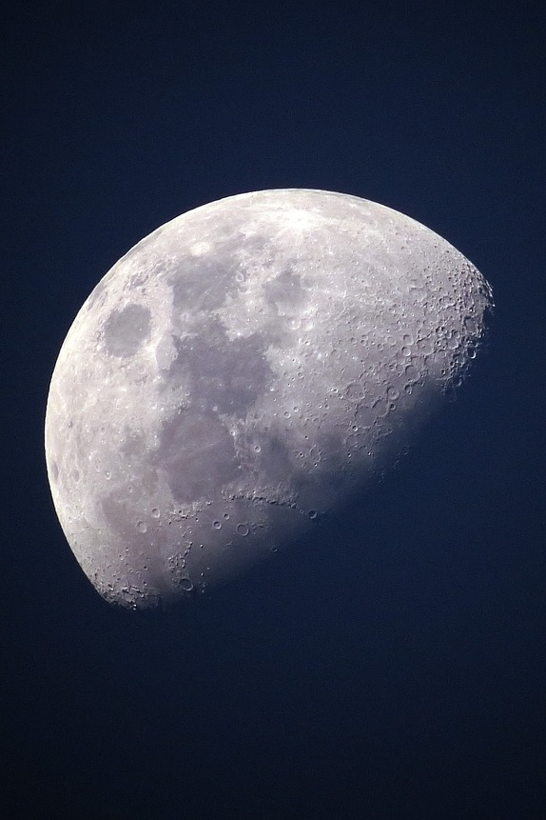
Action
The agent takes an action based on its current state.
There are four discrete actions: do_nothing, fire_left_engine, fire_right_engine, and fire_main_engine.

Slide 5
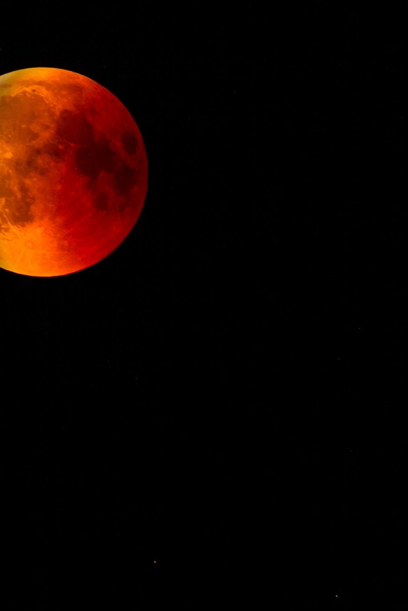
Reward
The agent receives a small negative reward every time it acts to encourage landing the lander quickly and efficiently.
If the lander crashes or comes to rest, the episode is considered complete and the agent receives additional -100 or +100 points depending on the outcome.

Slide 6
Understanding Deep Q-Network (DQN) Algorithm
An introduction to Deep Q-Network (DQN), a reinforcement learning algorithm that combines Q-learning with deep neural networks to learn optimal policies in environments with large state spaces and discrete actions.

Slide 7
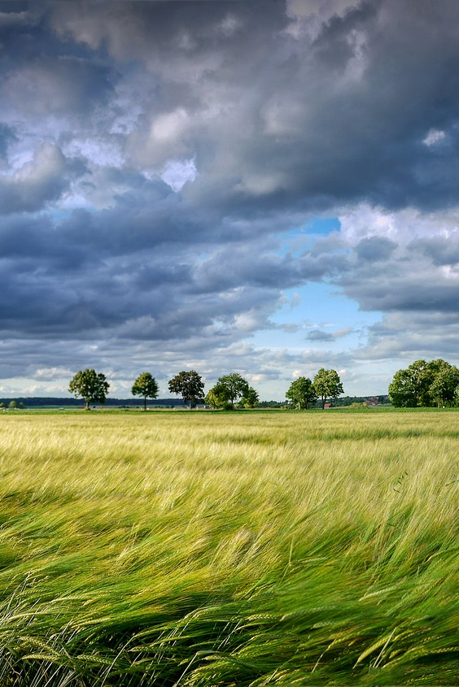
Basic Idea and Q-Function Approximation
DQN combines Q-learning with deep neural networks to learn optimal policies in complex environments.
The neural network approximates the optimal Q-function, which is the expected total reward for an agent in a given state taking a particular action and following the optimal policy thereafter.
The neural network outputs a vector of Q-values, one for each possible action.

Slide 8
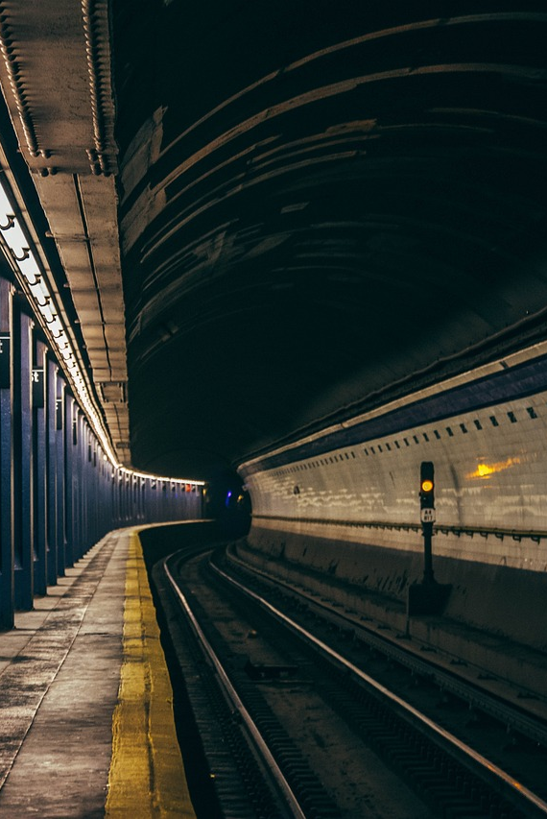
Experience Replay
DQN uses experience replay to improve the stability and efficiency of learning.
The agent stores transitions (state, action, reward, next state) in a replay buffer and samples from it randomly to train the neural network.
This helps to decorrelate the data and prevent overfitting.

Slide 9
Epsilon-Greedy Policy
The agent selects the action with the highest Q-value, according to an epsilon-greedy policy.
Epsilon-greedy policy ensures that the agent explores the environment while exploiting the learned policy.

Slide 10
Target Network
DQN employs a target network to stabilize the learning process.
The target network is a copy of the main network that is periodically updated with the weights of the main network.
This reduces the correlation between the target and predicted Q-values and improves the convergence of the algorithm.

Slide 11

Applications and Successes
DQN has been successful in learning to play a variety of Atari games and other complex environments.
The algorithm has paved the way for many subsequent advances in deep reinforcement learning.

Slide 12
Necessary Libraries used
1)Tensor flow
2)Keras
3)Matplotlib
4)Numpy
5)Gym
6)Torch
7)IPython
8)glob

Slide 13
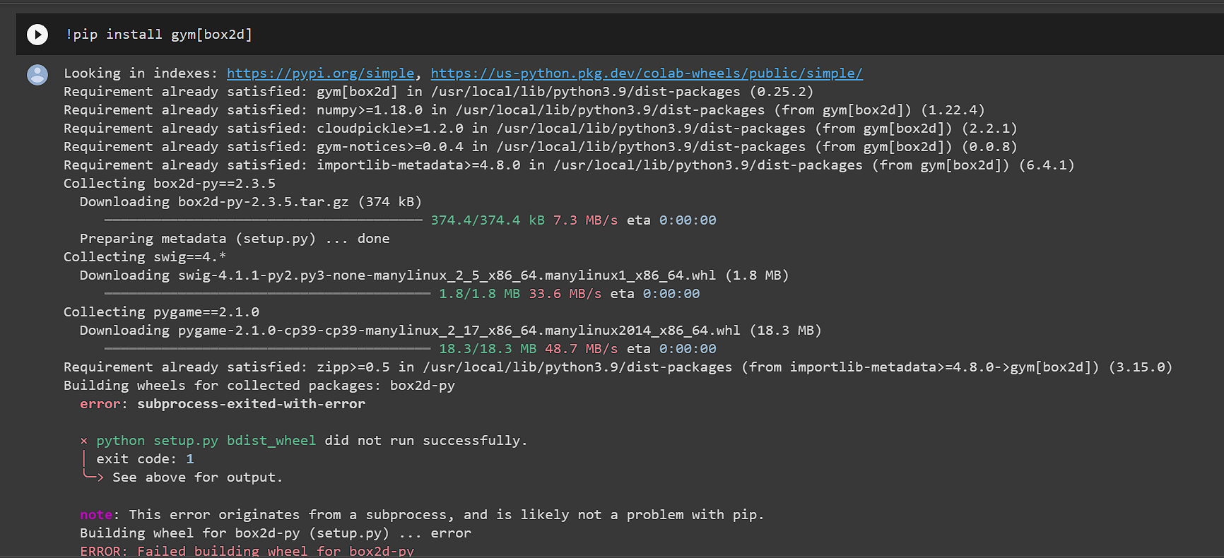
Installing environment

Slide 14
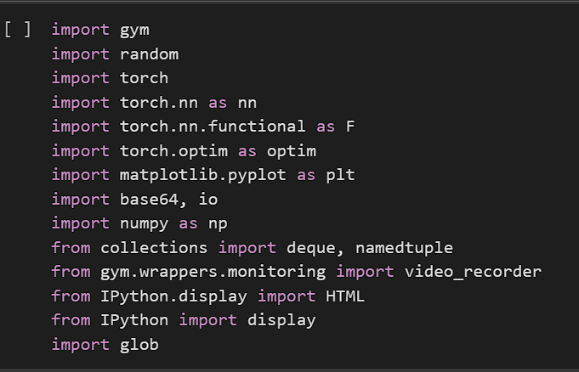
Importing necessary libraries

Slide 15
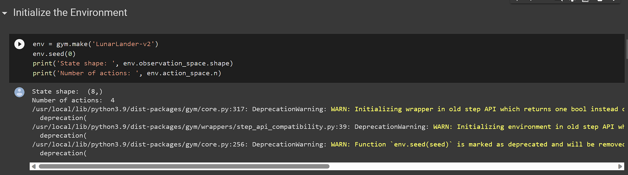
Initializing Environment

Slide 16
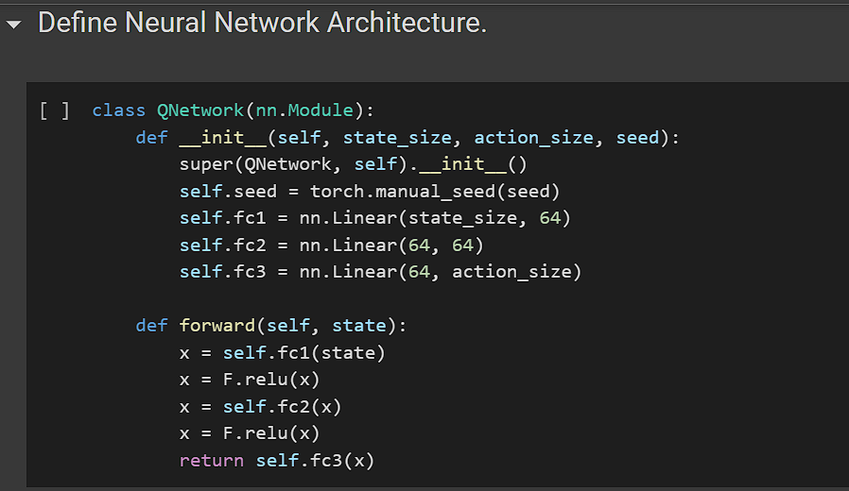
Defining Neural Network Architecture

Slide 17
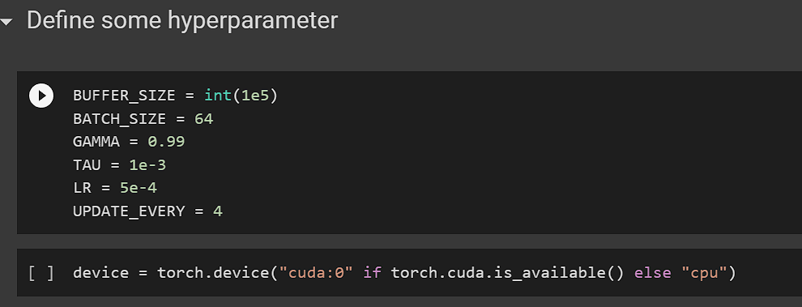
Hyper Parameter

Slide 18
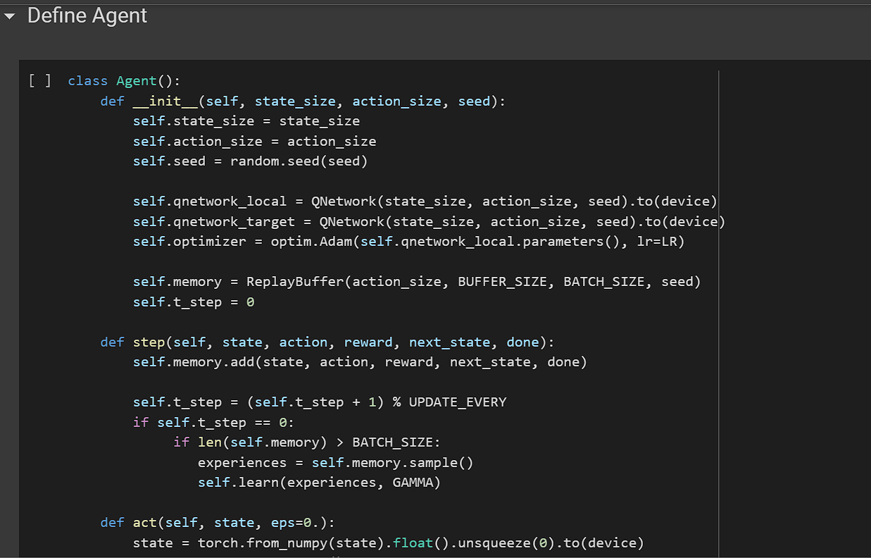
Creating Agent

Slide 19
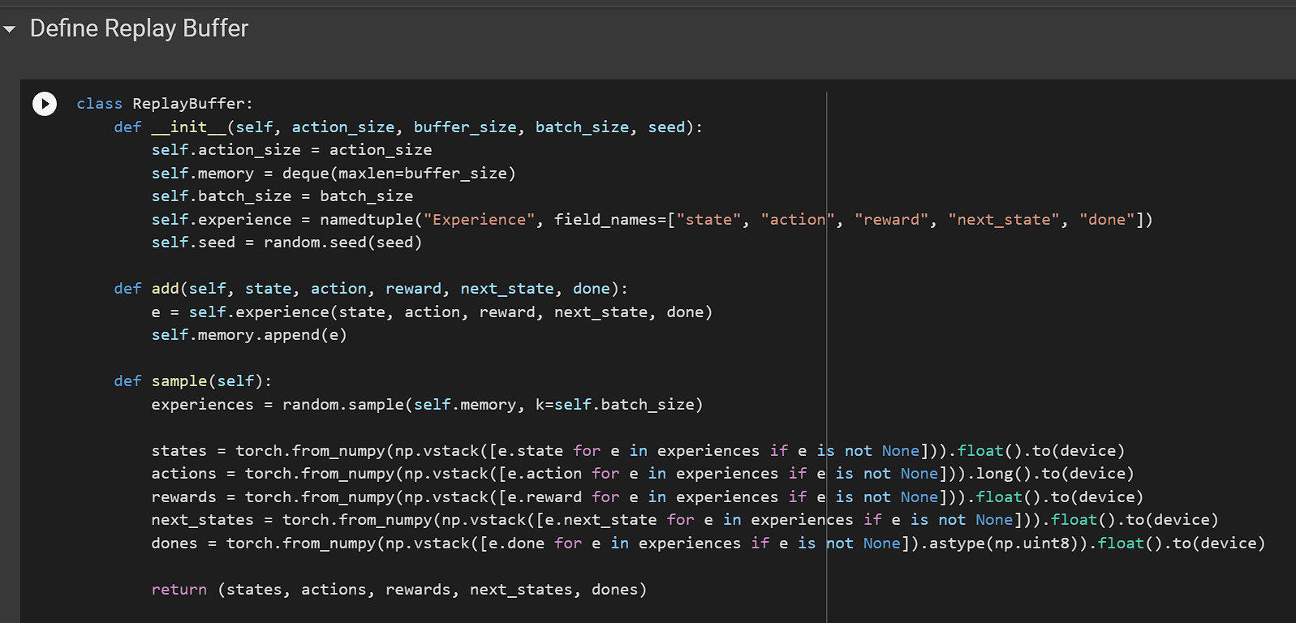
Replay Buffer

Slide 20
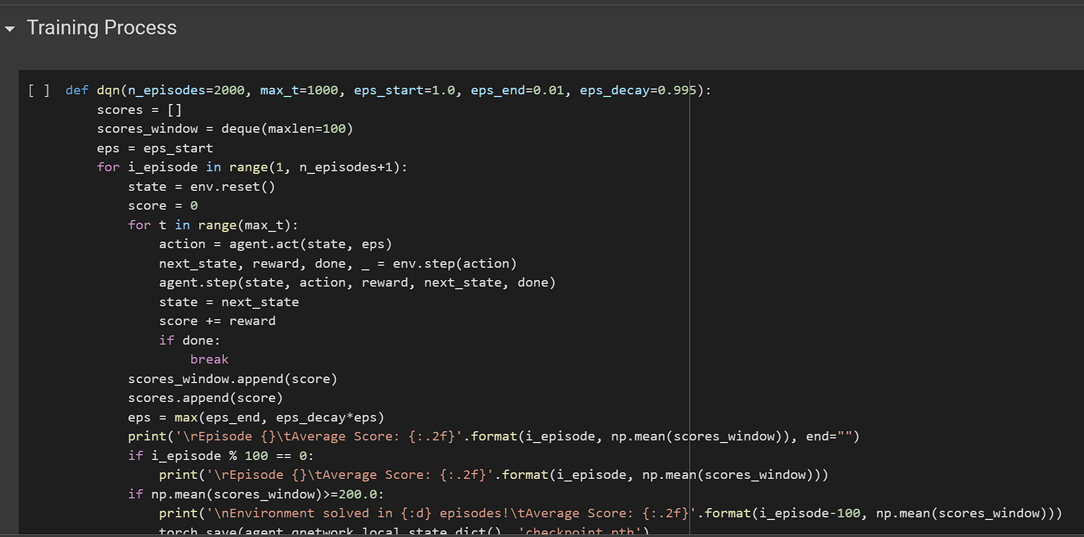
Training Process

Slide 21
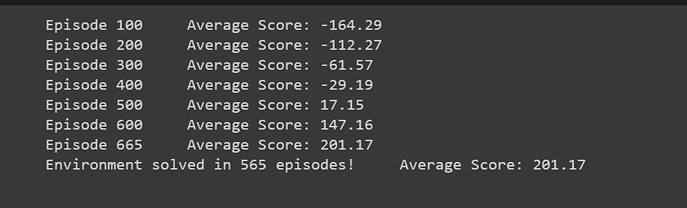
Training Result

Slide 22
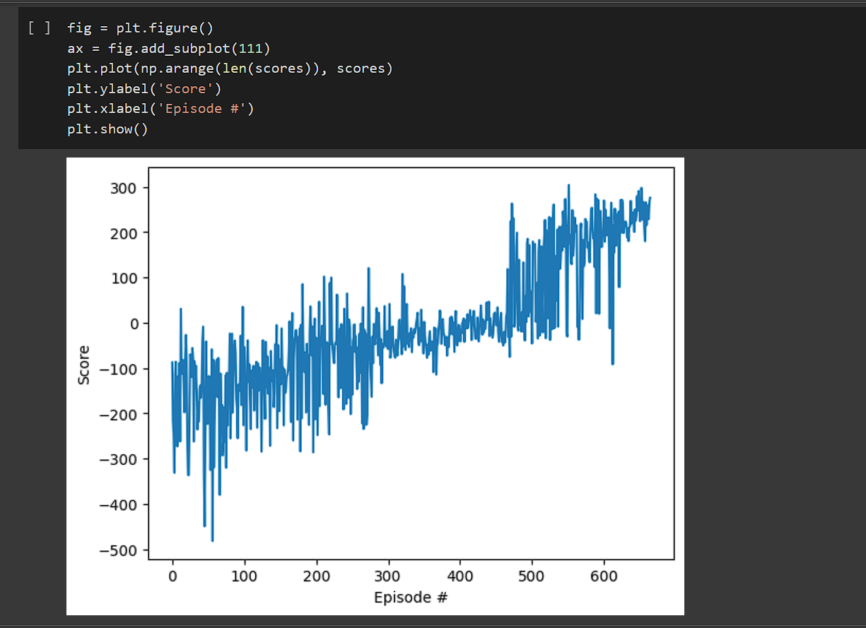
Plotting the Result

Slide 23
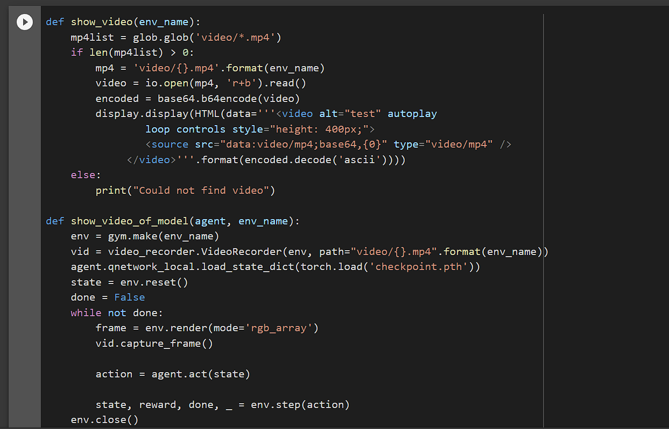
Creating the video animation

Slide 24
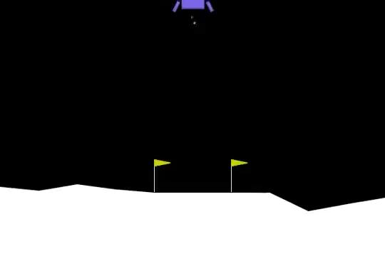
Output

Slide 25


